Slide 1


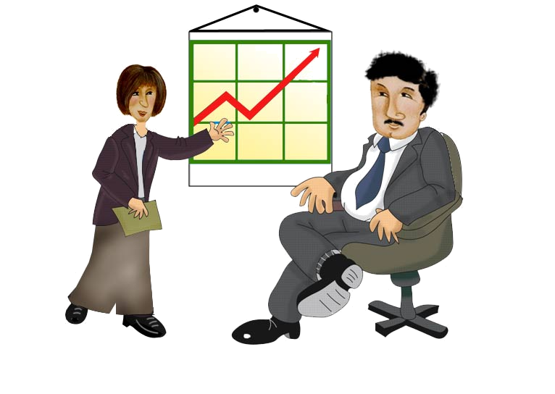

Medium: Visual
Message
received
Message
sent
Medium: Speech
Sender
Receiver

Slide 2

Medium: Visual
Feedback
Message
received
Message
sent
Medium: Speech
Sender
Receiver
Notes:
Sheh:This whole slide can be animated after the initial laugh of the previous slide. The order is
Sender > message > coding: speech, visual > receiver > message received > decoding > feedback.

Slide 3



Slide 4

Think of the Message
Sender
Write or Phrase the Message
Feedback
Send or Speak the Message
Read or Listen to the Message
Receiver
Understand the Message
Respond to the Message

Slide 5

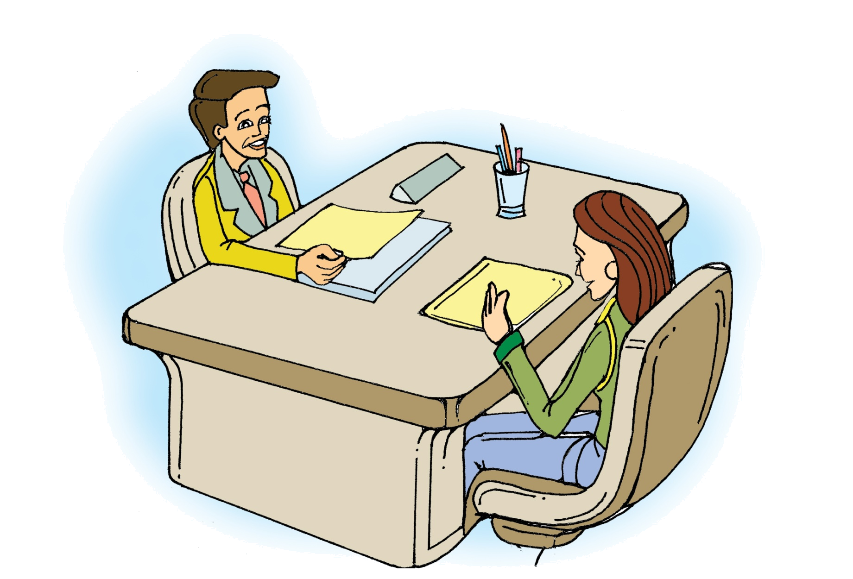

Slide 6
Communication
The process by which information and feelings are shared by people through an exchange of verbal and non-verbal messages

Slide 7

Verbal Communication
  With words
  • Oral - spoken word
  • Written - letters, e-mails, proposals
Non-Verbal Communication
  Without words
  • Body postures
  • Hand gestures
  • Facial expressions
  • Voice tone-pitch

Slide 8

• Be clear, concise and accurate
• Present ideas in orderly manner
• Face audience and maintain eye-contact
• Listen, understand and respond
• Use proper body language
• Maintain right distance
• Have the right voice modulation and proper volume
• Avoid confusion and misunderstanding

